Slide 1


My Road to GopherCon 2020
Doug Donohoe (he/him/his)

Slide 2
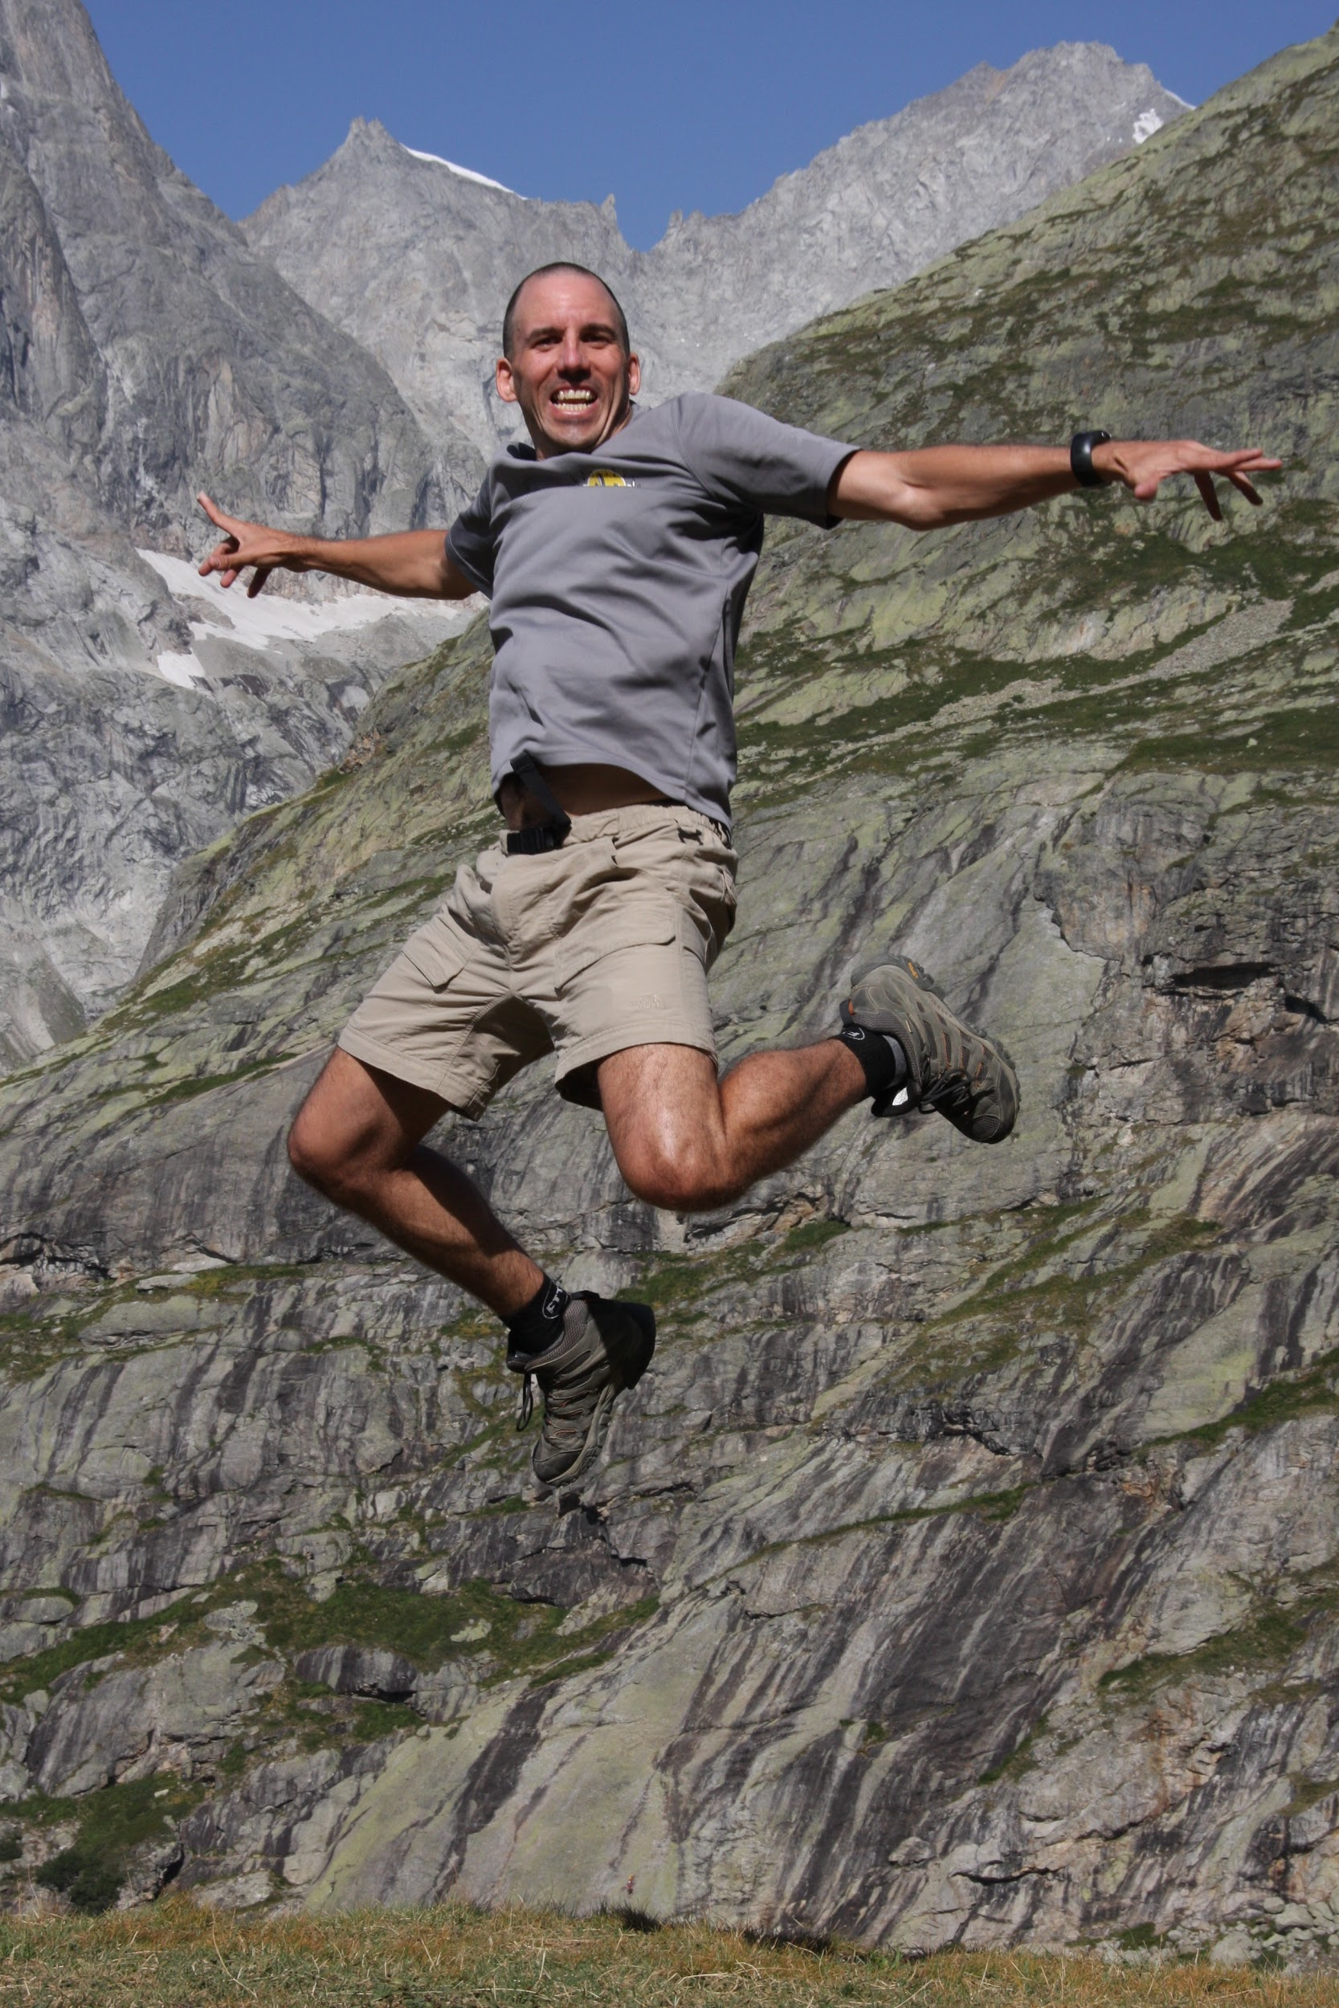






My Background

Slide 3








My Languages
Notes:
Professionally, I have the most experience with the JVM languages: Scala, Java and Groovy.
I’ve also done a couple of projects in Python and Ruby
A long time ago, I did C and C++ programming at Netscape
I started programming in Go a little over a year ago, when I joined the New York Times

Slide 4
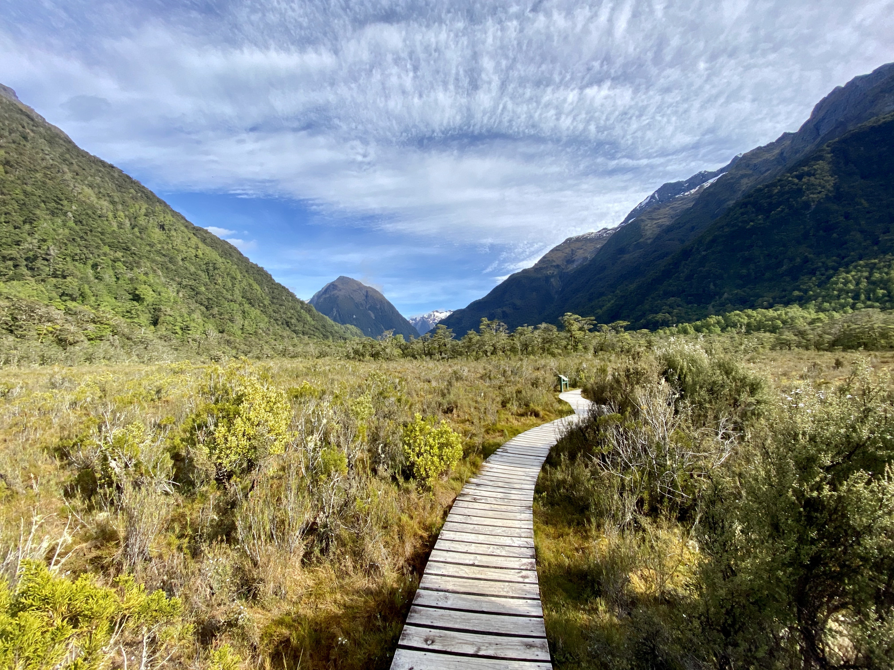
To Present or Not to Present?
Learned about GopherCon at internal NYT Go users group meeting on December 16th, 2019
Deadline was January 10th, 2020
I was out of the country December 20th – January 5th, leaving me only 5 days to prepare a submission
Milford Track, NZ – Dec 30th, 2019

Slide 5
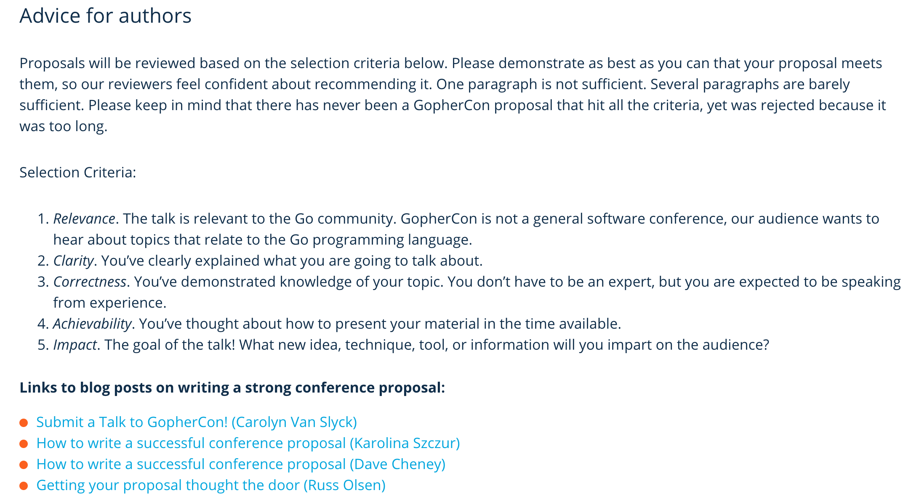
Call for Proposal
www.papercall.io/gophercon-2020
Relevance
Clarity
Correctness
Achievability
Impact

Slide 6
Conference Submission Form
Title – Talk “Headline” (or “Hed” in journalism jargon)
Elevator Pitch – 300 characters to sell my talk
Description – Seen by reviewers and attendees
Notes – Why me?
Detailed Talk Outline
Creative, clear explanation: why is this unique?
First time speakers encouraged
Priority give to new content
Double-blind selection process

Slide 7
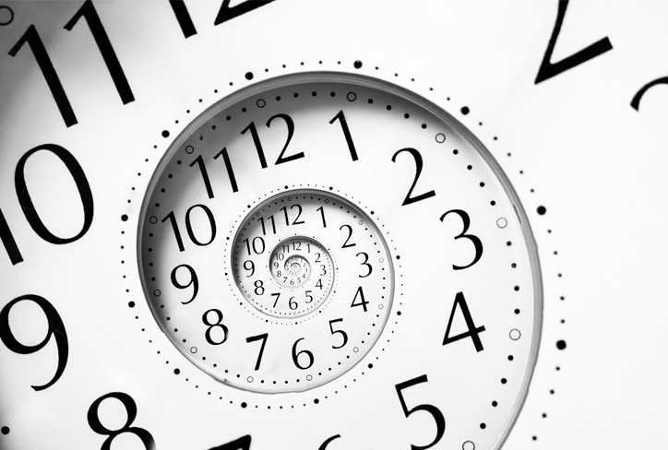
This might take a while…

Slide 8
Start with the Title and Go From There
Reordering 59 million New York Times publishing assets using Go and BadgerDB
Every version of every New York Times article since 1851 and related assets (e.g. images, tags) is stored in Kafka, but not 100% ordered correctly chronologically or topologically. Learn how we reordered 59 million events in-memory using BadgerDB (with code and lessons learned).

Slide 9
And it Did Take Time
Wrote over 2000 words total (seven pages)
Description 294 words
Notes 298 words
Outline 152 bullets
Took about 7 hours, which is in line with my historical “hour per page” metric when writing documentation
Submitted 4:30pm on January 10th, the day of deadline (7.5 hours to spare!)

Slide 10

Now we wait…

Slide 11
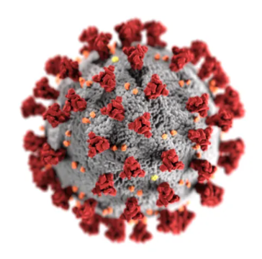
Timeline
Notified of selection on February 12th, 2020
Procrastination (I’ve got 4.5 months until June 22nd!)
March 12th - Covid
April 29th – Conference postponed to Nov 13th
More Procrastination (I’ve got 5.5 months!)
July 10th - Conference changed to GoVirCon Nov 9th
More Procrastination (I’ve still got 4 months!)
September 2nd – Conference organizers reach about about how to record my talk with new 10/9 deadline!

Slide 12
I’ve Got a Month to Write My Presentation

Slide 13
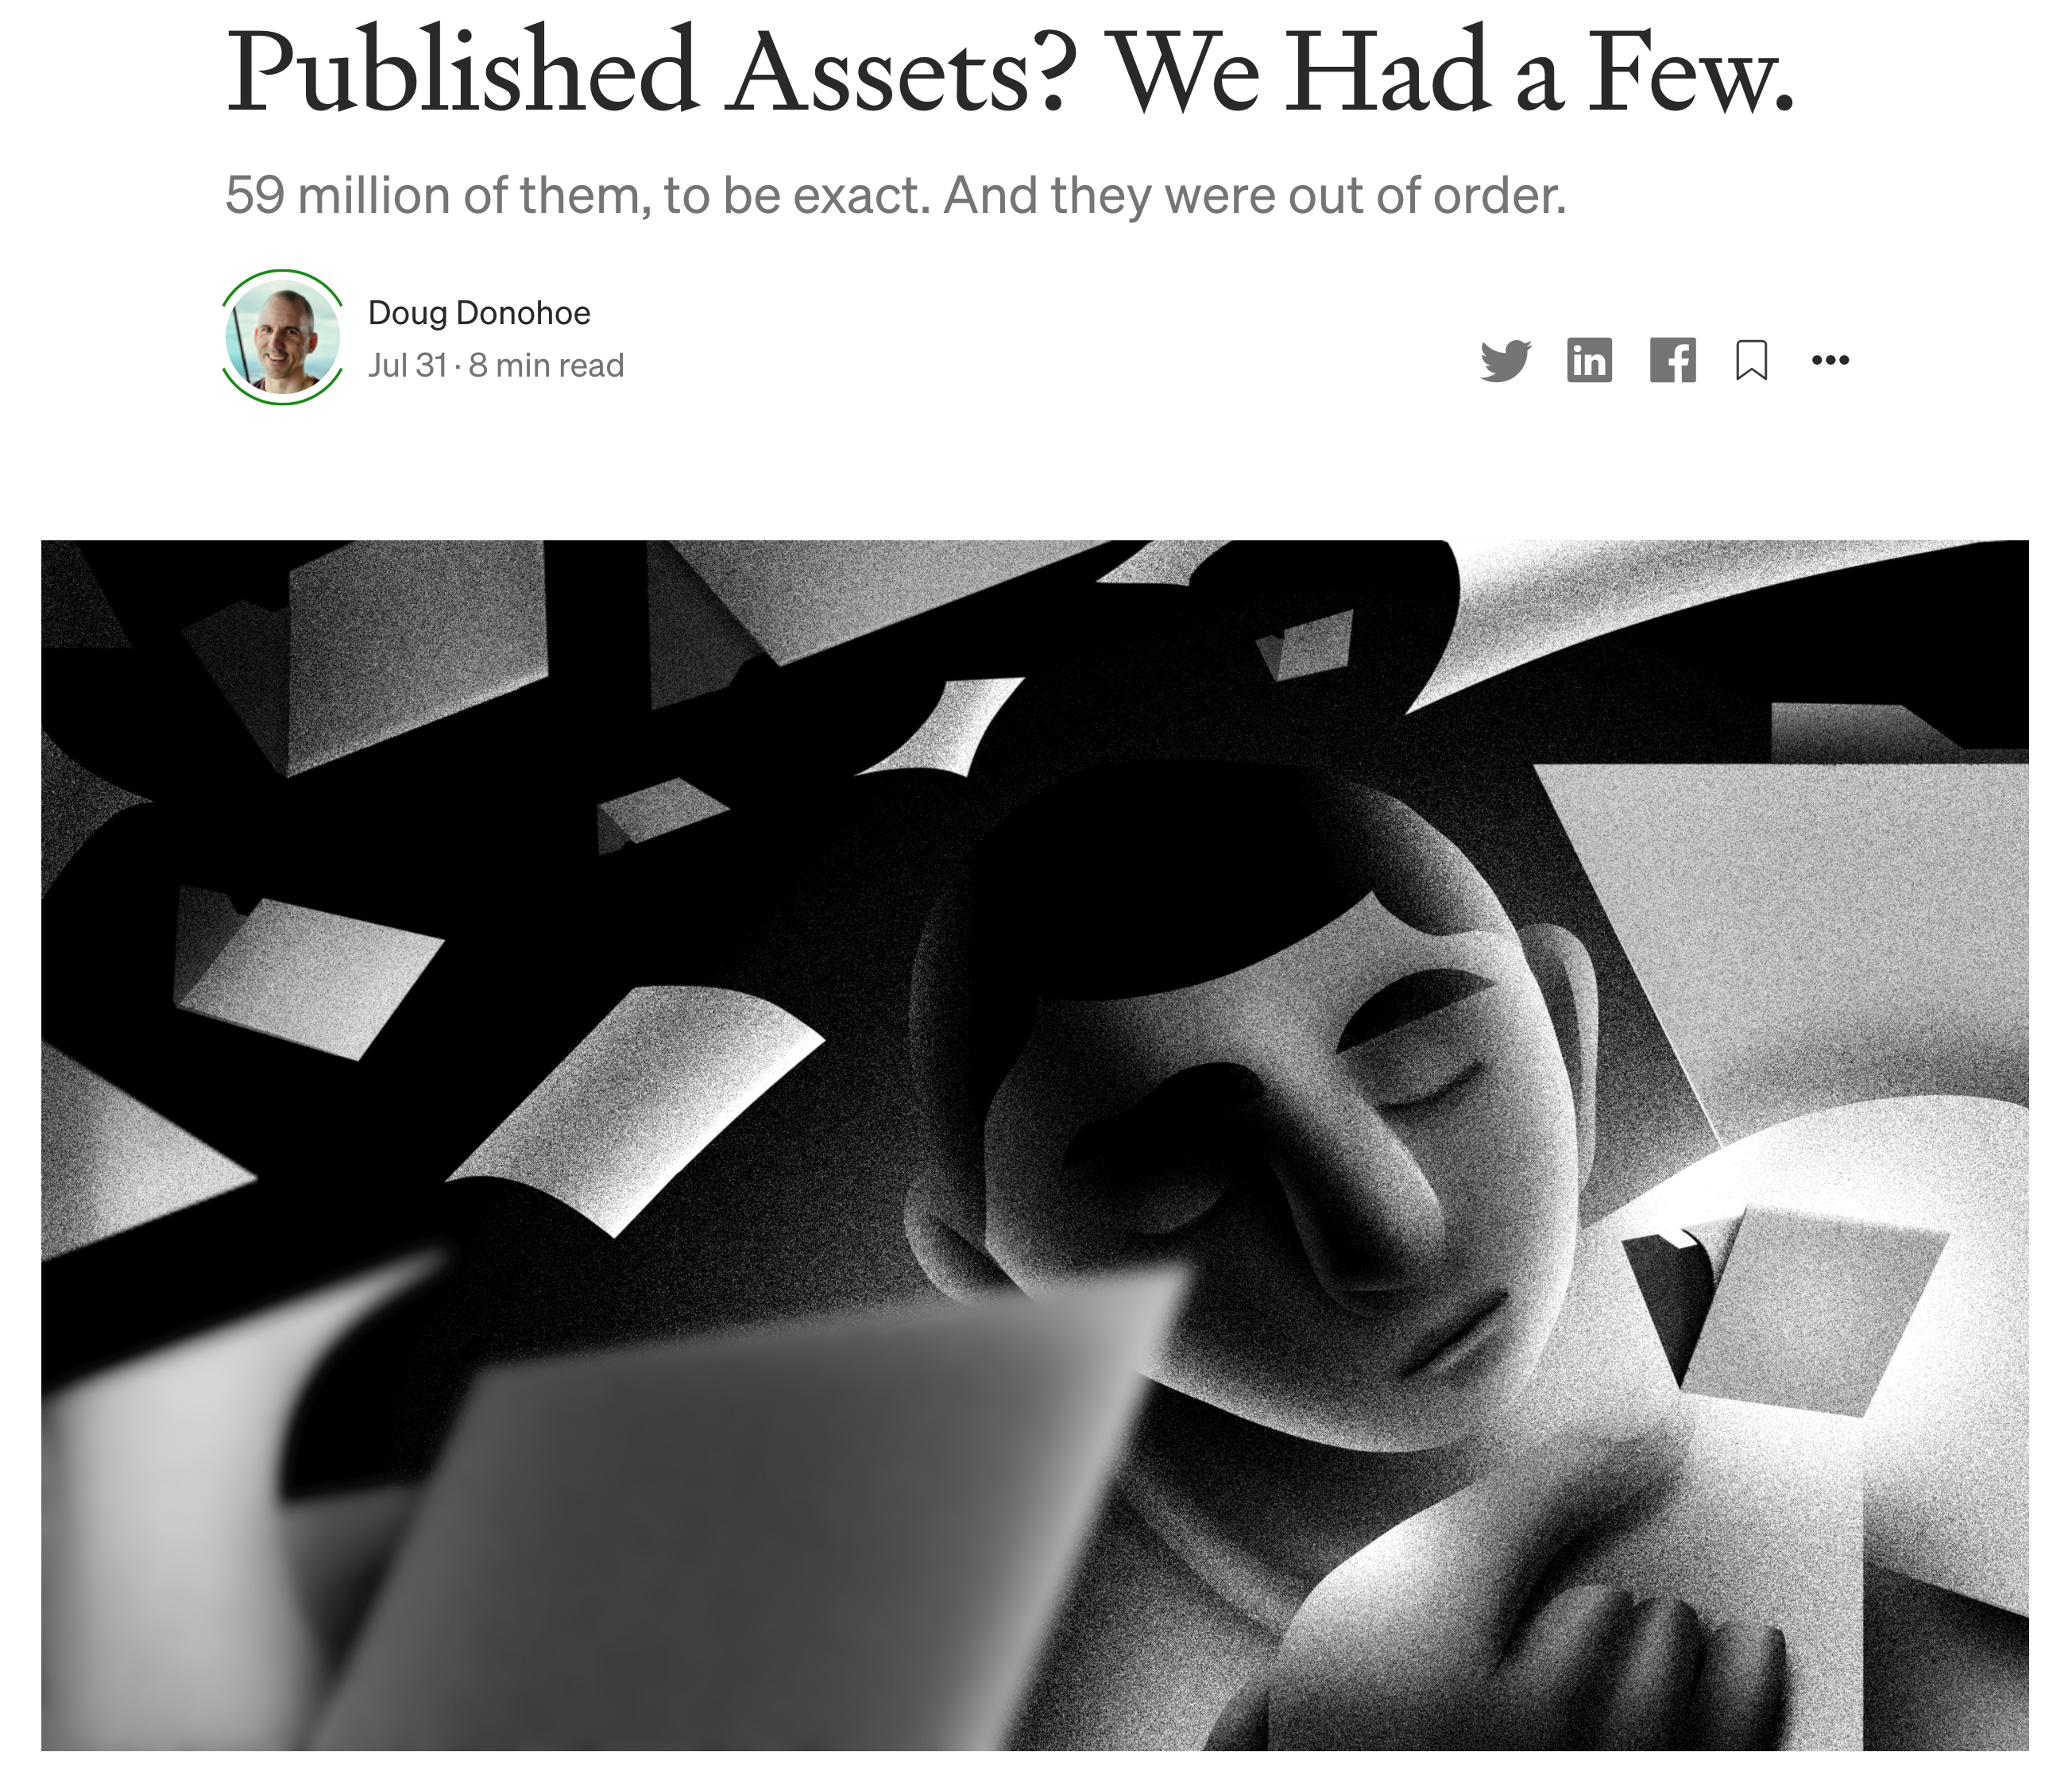
Time to Get to Work
I had done some work to start with. I published a related NYT Open article in July
https://tinyurl.com/dd-nyt-59
Writing took about 20 hours
First slide created September 11th
Ended up with 60 slides for a 45 minute talk
Took about 40 hours to create + refine
Here are four of my favorites

Slide 14
Favorite #1

Slide 15
Assets Refer to Each Other
Article 1
Article 2
Image 1
Image 2
Subject 1
Section 1
Person 1
Person 2
Notes:
Assets refer to each other by the URI
Assets are often shared across different assets (e.g., Subject)
Click - Assets are re-used across different instances (e.g., Section, Subject from Article 1, Article 2)

Slide 16
Assets Are Published in Topological Order
Article 1
Article 2
Image 1
Image 2
Subject 1
Section 1
Topological Sort
Person 1
Person 2
Notes:
Assets are effectively published sequentially (more on this in next slide)

Slide 17
Favorite #2

Slide 18
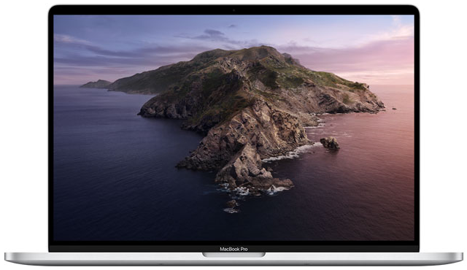
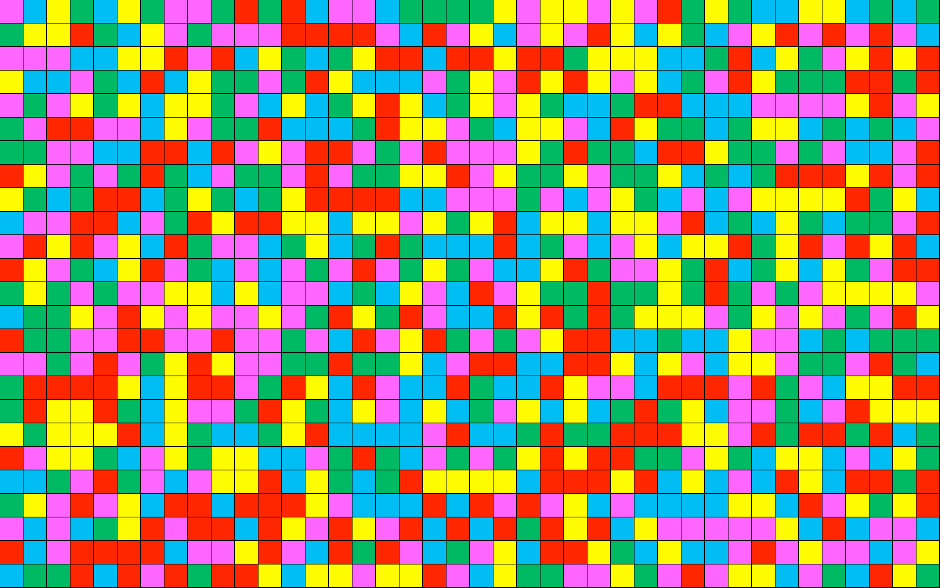

Inspiration
I didn’t think this was a “big data” problem with billions of records or petabytes of data
My new laptop had 16 GiB of RAM – could I fit all 59 million assets into memory?
16 GiB divided by 59 million is roughly 300 bytes, so it seemed possible!
💡 Maybe I could use a Key-Value Database?

Slide 19
Python Code to Create Grid
def random_color(): colors = ['#00B0F0', # blue '#00B050', # green '#FF0000', # red '#FF40FF', # magenta '#FFFF00' # yellow ] return colors[randint(0,
len(colors)-1)]
def main(): seed(clock()) # Initialize RNG top_left_x = 100 top_left_y = 100 width = 30 height = 30 num_rows = 25 num_columns = 40
window = GraphWin('Grid', 1800, 900) for r in range(num_rows): y = top_left_y + (height * r) for i in range(num_columns): x = top_left_x + (i * width) top_left_point = Point(x, y) bottom_right_point = Point(x + width, y + height) enclosing_rectangle = Rectangle(top_left_point,
bottom_right_point) enclosing_rectangle.setFill(random_color()) enclosing_rectangle.draw(window) time.sleep(5000) main()

Slide 20
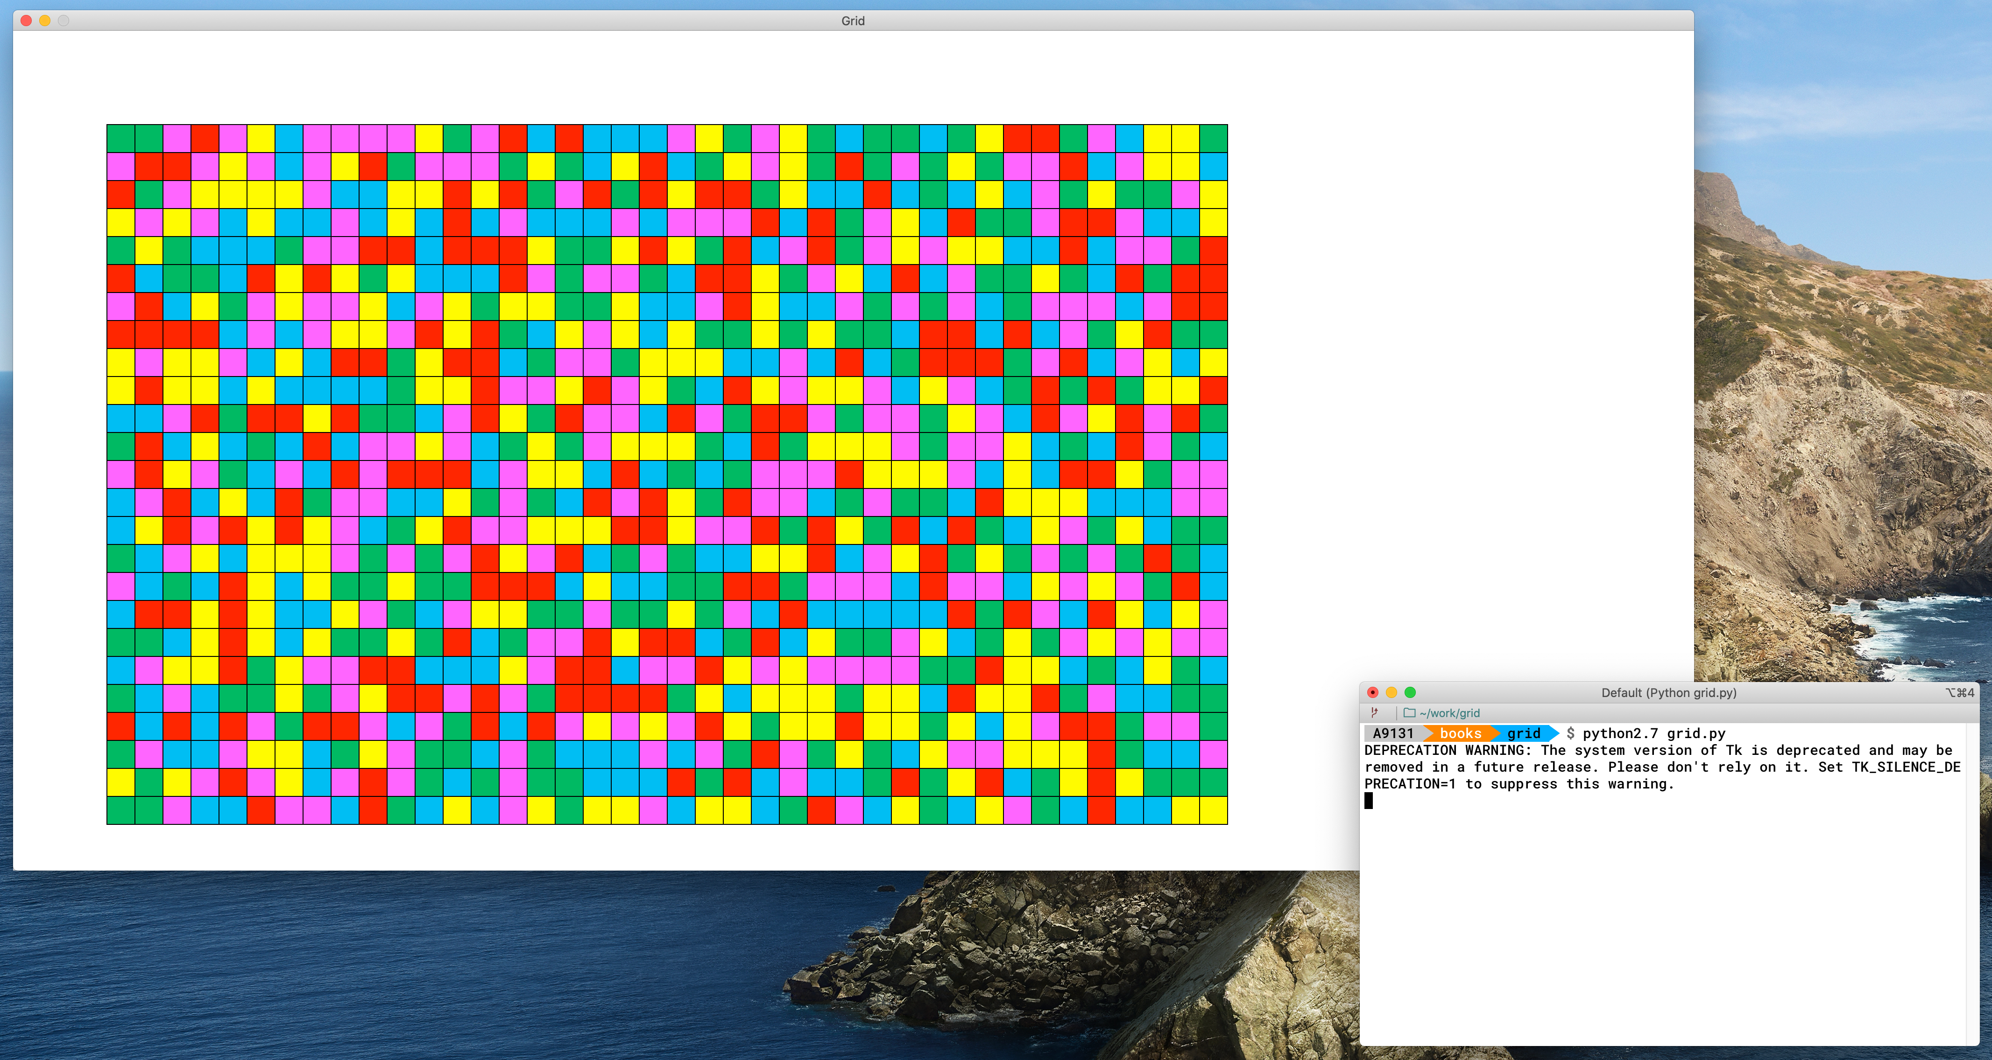
Creating Grid

Slide 21
Favorite #3

Slide 22
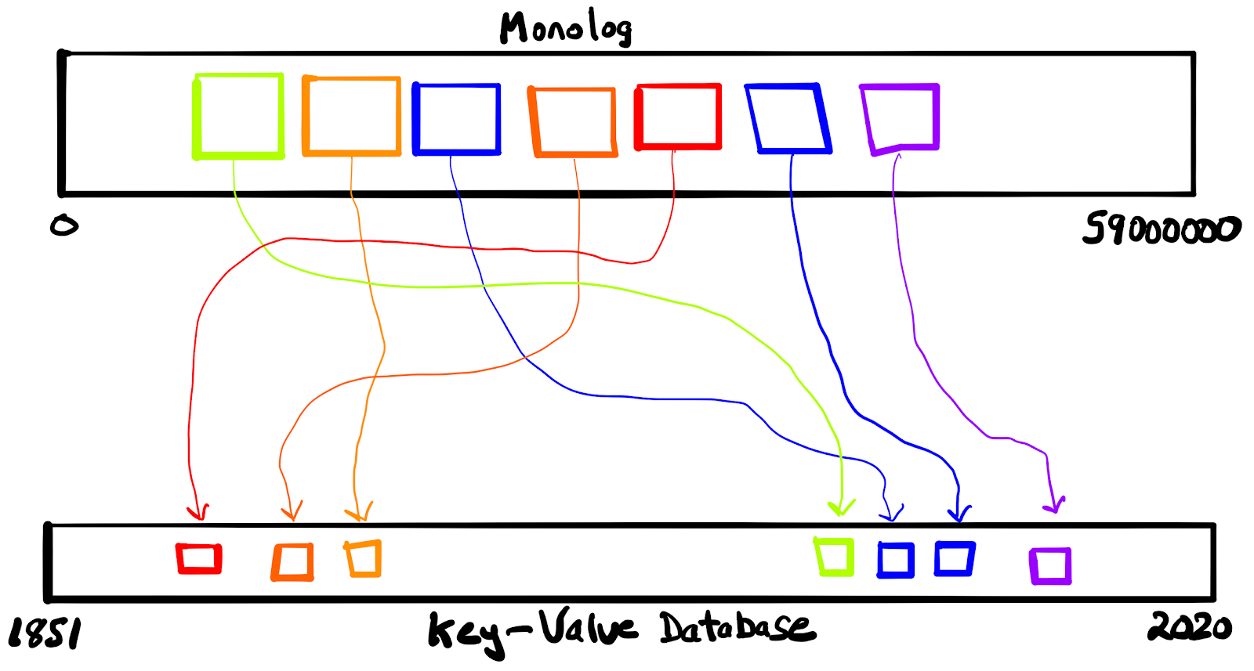
My NYT Open Post Had This Drawing

Slide 23
Step 1: Encode Assets and Insert Into Database
Monolog
0
59000000
1851
Key-Value Database
2020
Iterate By Timestamp
Notes:
Going to walk through the high-level parts of the algorithm. In practice there are a few more steps, but these are the key steps
1. Encode each asset into essential parts: unique id, publication dates, references to other assets, fingerprint “MD5”
2. Insert into a key value database, using timestamp as key. Adjust nanoseconds to make timestamp unique
3. Doing this allows us to iterate by timestamp, from earliest to most recent

Slide 24
Favorite #4

Slide 25
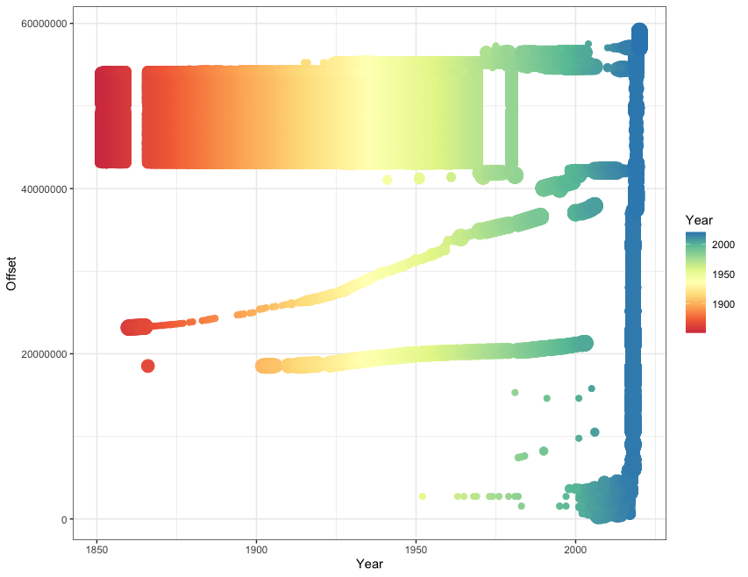
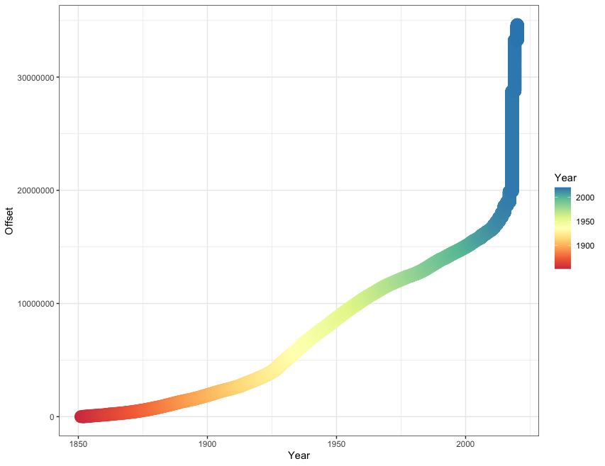
Order is Restored

Slide 26
R Code
# Monolog Sort Talk Graphs
library("ggplot2")
setwd("/Users/donohoe/disks/sorting/log")
options(scipen=9)
years <- read.csv("year-stats.csv")
sort <- read.csv("year-stats-sorted.csv")
x = brewer.pal(n=9, name="Spectral")
# Before
ggplot(years, aes(y=Offset, x=Year))
+ geom_point(aes(color=Year, size=log(Count)))
+ scale_color_gradientn(colors=x)
+ scale_size_binned(n.breaks = 10)
+ theme_bw() + guides(size = FALSE)
# After
ggplot(sort, aes(y=Offset, x=Year))
+ geom_point(aes(color=Year, size=log(Count)))
+ scale_color_gradientn(colors=x)
+ scale_size_binned(n.breaks = 10)
+ theme_bw() + guides(size = FALSE)

Slide 27
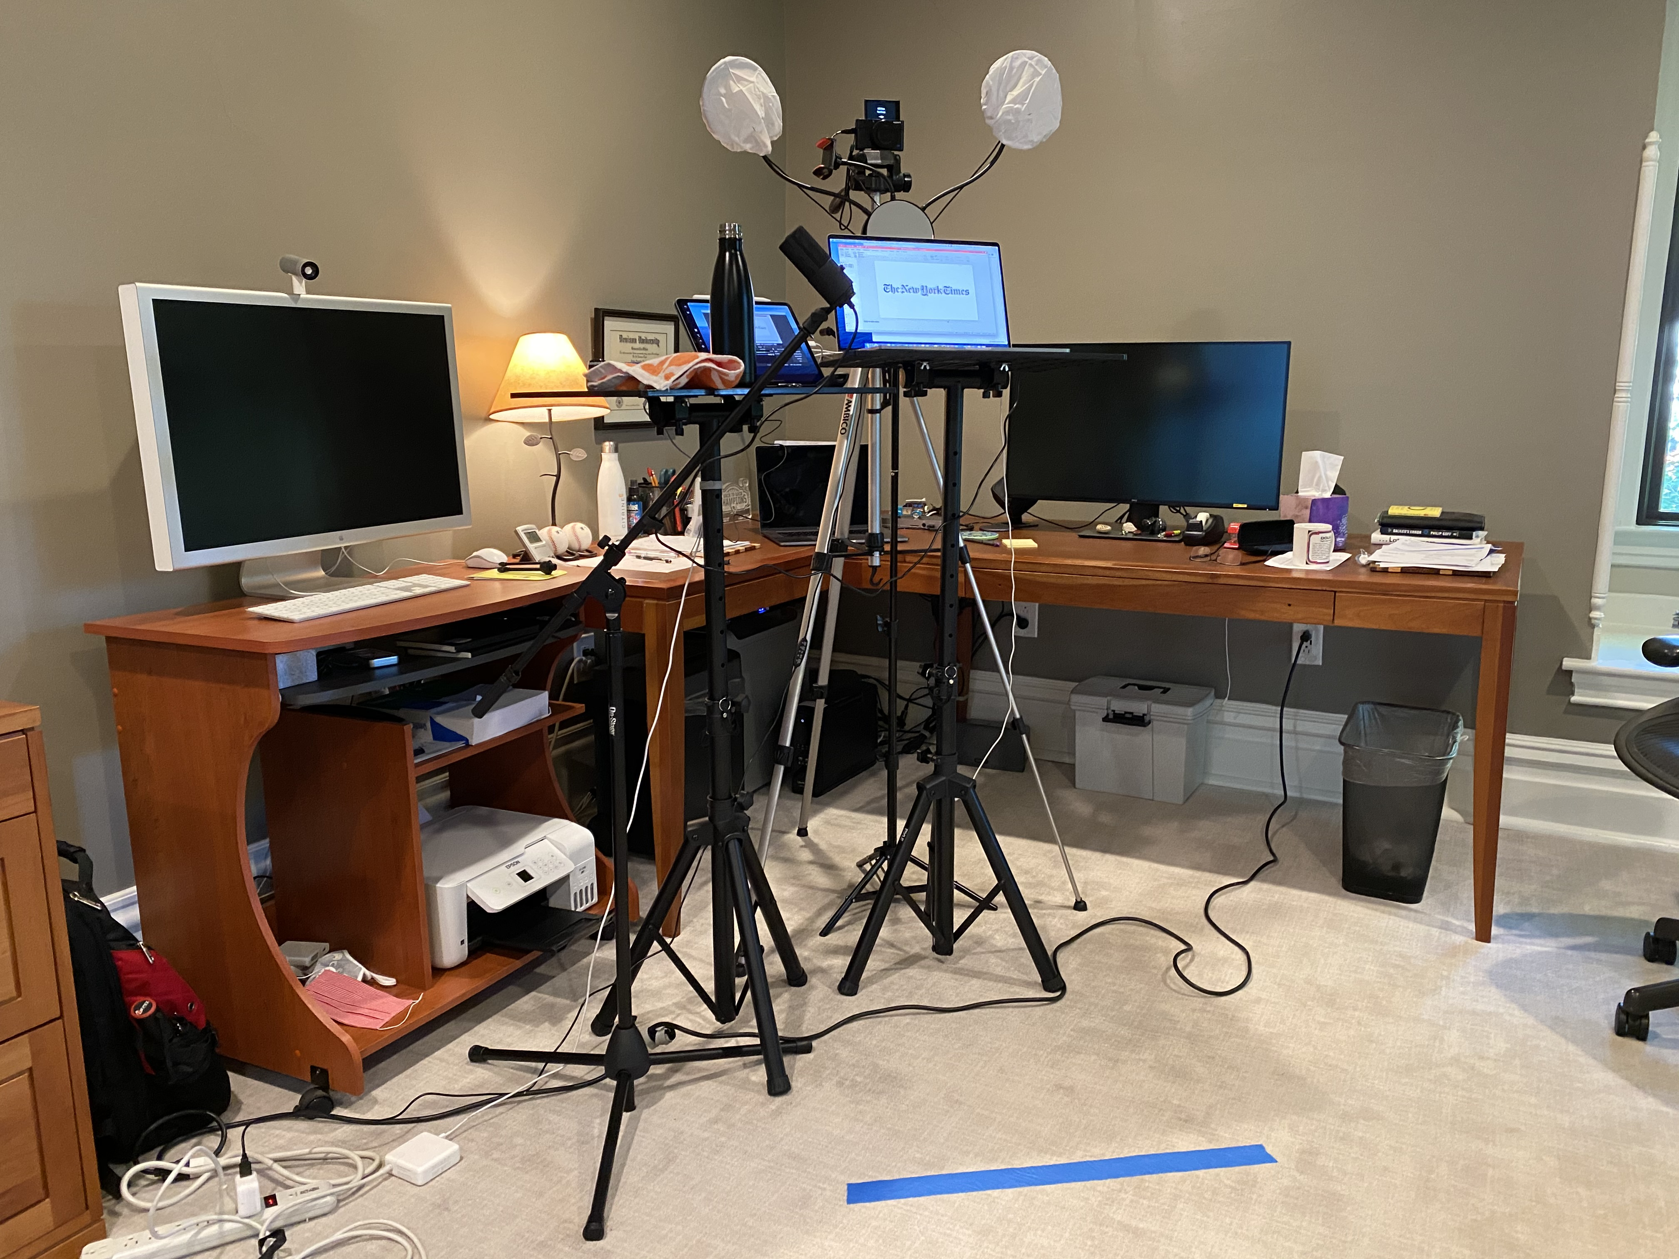
My Recording Studio
Notes:
GohperCon sent me an Amazon gift card for all this equipment
I used my Sony to record video
Spent 3-4 hours getting setup right. Used something called OBS Studio

Slide 28
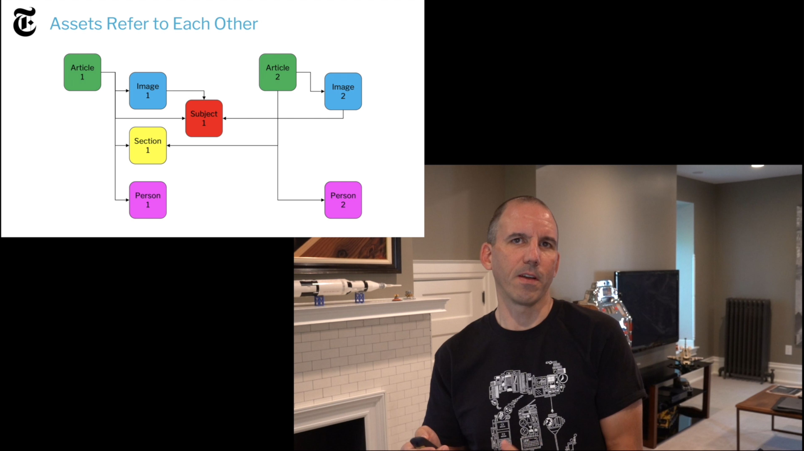
How It Might Look
Notes:
Took two full attempts to record this
I did a dry-run internally in front of our Go user group
I also did a 30 minute version of this talk for Dgraph community

Slide 29

Closing Thoughts
Creating a presentation is hard work, but worth it
My talk is Wednesday November 11th, 2:10-2:55pm www.gophercon.com/agenda/speakers/608793
GopherCon 2021 Call for Papers opens December 1st
Go for it!

Slide 30
Thank You

Slide 31


